Slide 1
Volatility Trading using Machine Learning
Amrit Prasad, Nathan Johnson, Salman Khan Pathan, Saurabh Kelkar

Slide 2
Problem Statement
Amrit Prasad
Nathan Johnson
Salman Khan Pathan
Saurabh Kelkar
Predict the volatility of the S&P 500 index
Compare predicted volatility levels over a specified time horizon with market implied volatility and select a portfolio of options + index to capture movements in the premium
Metric: 1. MSE 2. Trading Profitability
Challenge 3
Benchmark: GARCH (1,1)
ML Application for Volatility Prediction
Trading Strategy
Use GARCH(1,1) estimates of realized volatility
Backtest trading strategy as benchmark return
Multiple neural networks (e.g., Jordan Neural Network) demonstrate superiority to GARCH(1,1) models
Trade S&P options based on forecast volatility
Ex: Expected premium contraction, short option and delta-hedge with daily rebalancing

Slide 3
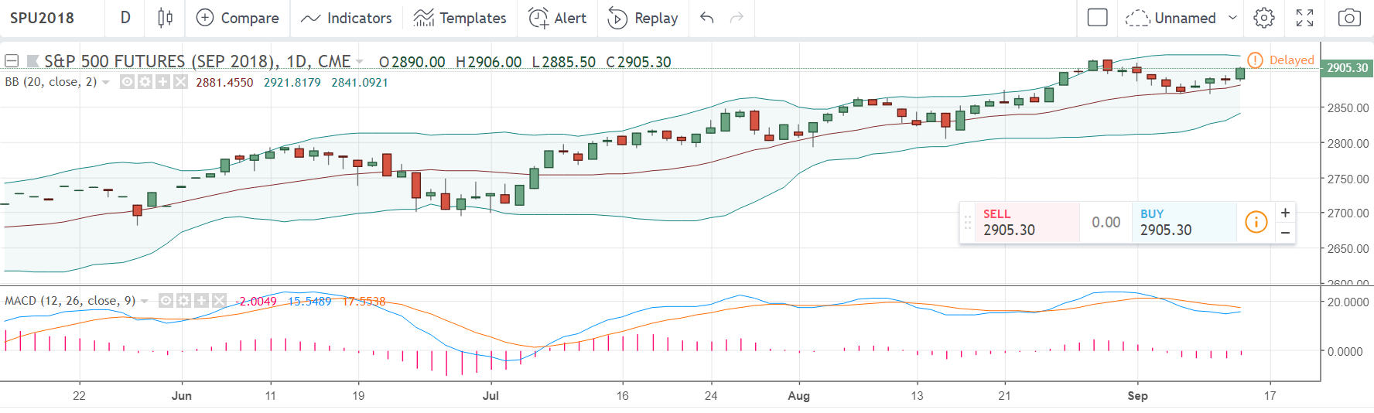
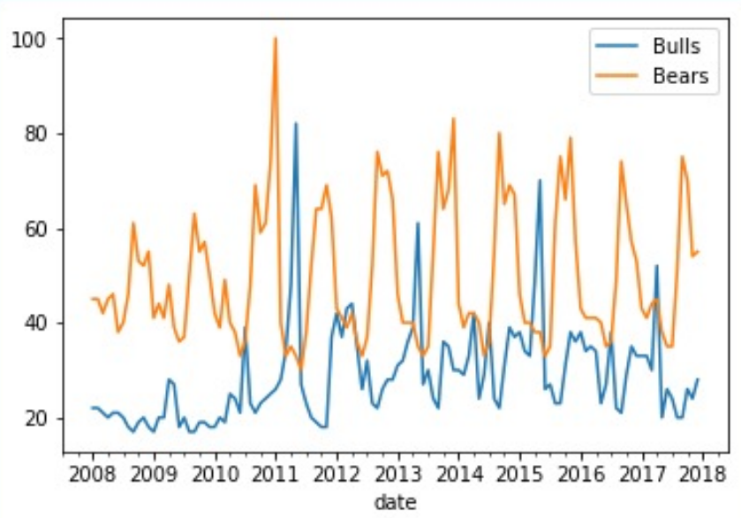
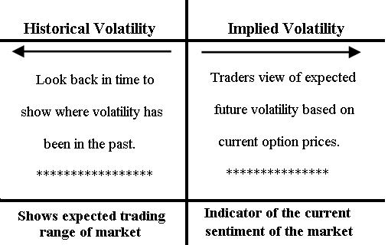
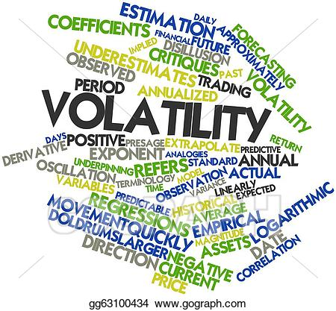
Data Sets: Stock Domain and Features
Amrit Prasad
Nathan Johnson
Salman Khan Pathan
Saurabh Kelkar
S&P 500 Index realized volatility
Set of traded options’ implied volatilities
Date: 1st Jan 2008 - 31st Dec 2017
Data Cleaning:
News Headlines scraped in JSON format
Time Series Data: Is clean
Technical/Price data
Google Trends
Implied Volatility
News Headlines
Source: Bloomberg
Usage: Technical Indicators based on OHLC Data.
Source: Google Trends API
Usage: Word count occurance in searches
Source: Option Metrics
Usage: Trading Backtester
Source: Scraping (WSJ Archives)
Usage: NLP

Slide 4
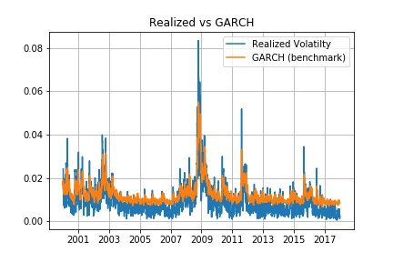
Benchmark
Amrit Prasad
Nathan Johnson
Salman Khan Pathan
Saurabh Kelkar
Volatility has various characteristics:
Clustering
Asymmetry
Regimes Behaviour
Long-Term Memory
GARCH(1,1) model is parsimonious and captures the clustering pretty well. However the asymmetric and regimes behaviour isn’t described desirably. The decay of the coefficient on older lags also leads to a loss of long-term memory.
Neural Networks and other ML algorithms have the ability to capture the missing aspects. They are particularly flexible as information apart from price returns can also be incorporated.
Key References:
[1] Tae Roh, Forecasting the volatility of stock price index
[2] Arnerić, et al, GARCH based artificial neural networks in forecasting conditional variance of stock returns

